Slide 1
Improved Situational Awareness and Understanding using Unmanned Aircraft Systems (UAS)
Robbie Hood
Office of Oceanic and Atmospheric Research
3 November 2010

Slide 2
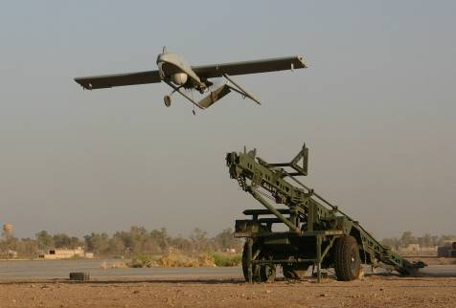
Reality of Unmanned Aircraft Systems
Proven platforms and payloads
Many classified at Technology Readiness Level – 9
Air Force and Navy Global Hawk - 20,000 flight hours over 10 years
Air Force and CBP Predator – 1M flight hours over 15 years
Army PM UAS – 1 M flight hours among 5 operational UAS models
Airspace Access improving
FAA Certificate of Authorization (COA) to flight - Approved for NASA and NOAA science missions
FAA flight rules for small low altitude UAS – Expected by 2013
Advancing DOD sense and avoid technologies – Army/FAA pilot study underway for 2010 - 2015
New capabilities on the horizon
High altitude Zephyr - flown for 2 weeks
DARPA technology investments – flight times
of months to years
UAS - launched from balloons or other aircraft

Slide 3
Manned and Unmanned Aircraft Performance

Slide 4
Tools for Building UAS Capacity
NOAA UAS for Improved Situational Awareness and Scientific Understanding
UAS Platform and Payload Demonstrations
Requirements Documentation and Trade Studies
Observing System Simulation Experiments and Information Management
Partnerships
Airspace, Safety, Training and Operational Procedures

Slide 5
NOAA UAS Strategic Vision and Goals
Vision
UAS will revolutionize NOAA observing strategies by 2014 comparable to the introduction of satellite and radar assets decades earlier
Goals
Increase access to UAS technologies for NOAA science community by 2013 in preparation for first operational implementation of UAS by 2014
Develop three comprehensive UAS mission strategies for:
High impact weather monitoring,
Polar monitoring
Marine monitoring
Foster new conceptual demonstrations for additional science topics like fire weather, flood, marine debris, fishery law enforcement, and rapid response monitoring

Slide 6
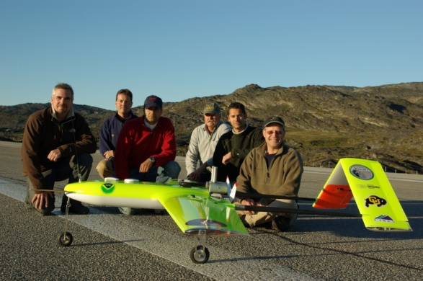
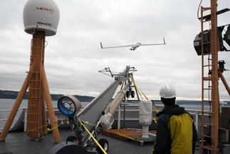
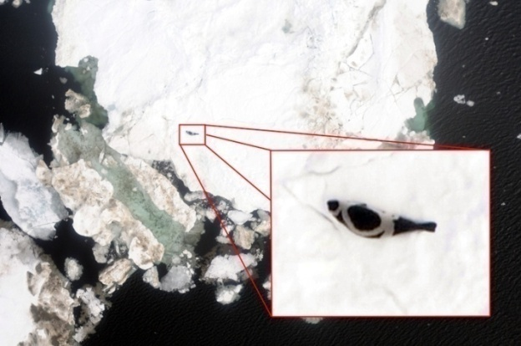
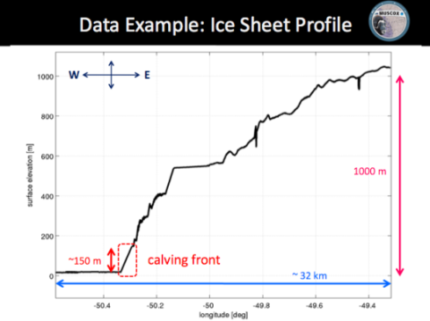
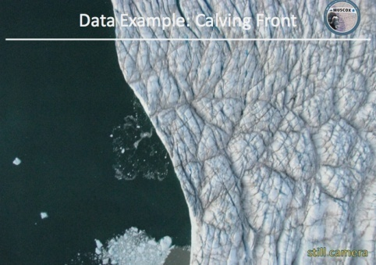
Polar Monitoring - Greenland Glacier and Ice Seal
Testbed Co-leads: Dr. Elizabeth Weatherhead (University of Colorado) and Dr. Robyn Angliss (NOAA/ National Marine Mammal Laboratory
Partners: Greenland Glacier Study / University of Colorado and BAE Systems -Advanced Ceramics Research
Bering Sea Ice Seal Study / University of Alaska- Fairbanks and Boeing - Insitu
Greenland Glacier Study - 2008
Bering Sea Ice Seal Study - 2009
Images courtesy of James Maslanik, University of Colorado
Images courtesy of Greg Walker, University of Alaska - Fairbanks

Slide 7
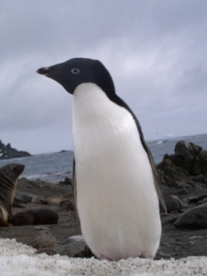
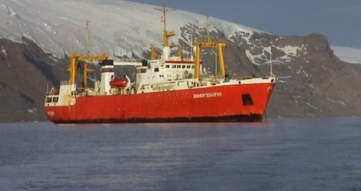
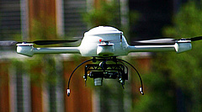
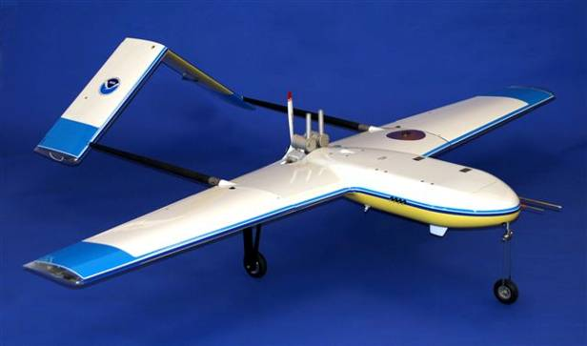
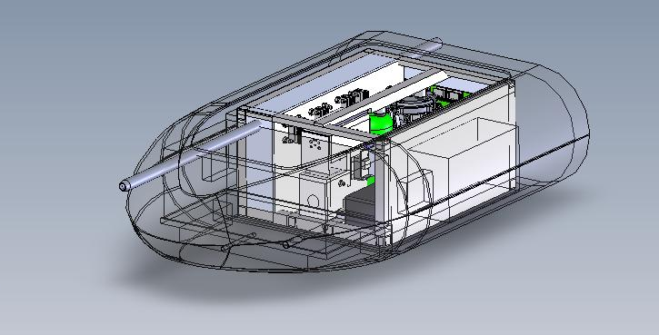
Polar Monitoring – Wildlife and Black Carbon
Antarctic Mission from Russian Ship
Arctic Black Carbon Mission in Partnership with Norwegian
and Russian Scientists
Temperature, Relative humidity
Ozone and Aerosol Sampler Payload

Slide 8
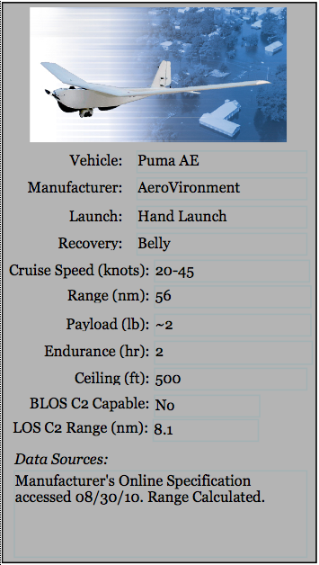
Marine Monitoring
2011 Partnership with Army UAS Program
Potential 2012 Missions
Marine Debris
National Marine
Sanctuary Surveys
Fisheries Law
Enforcement
Wildlife Assessments
Beach and Shoreline
Patrols

Slide 9
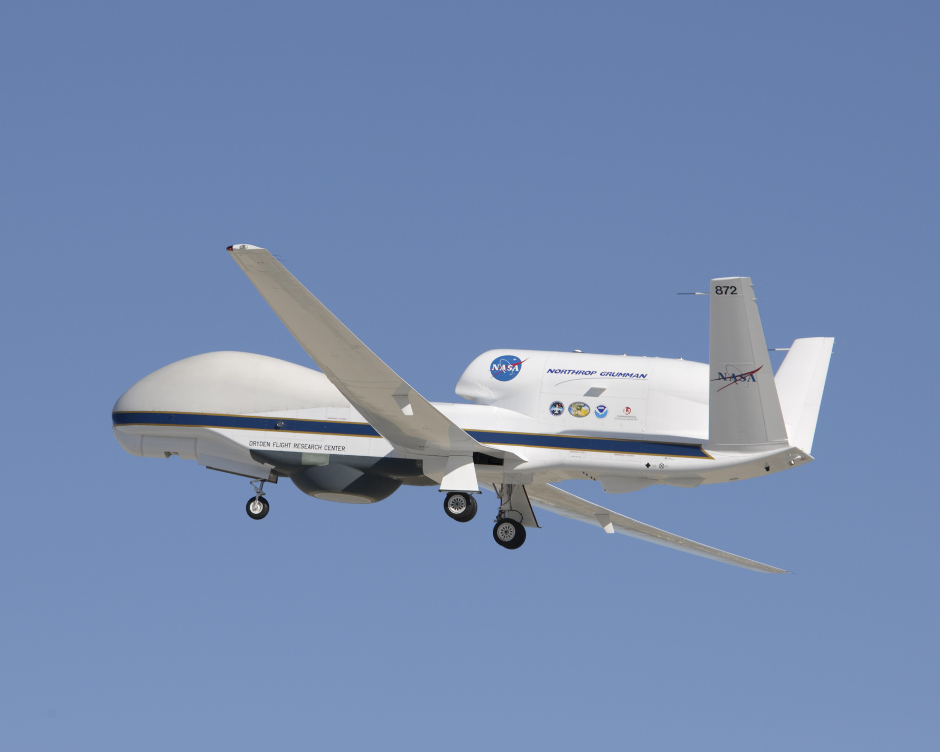
2010 Global Hawk Science Missions
NASA, Northrop Grumman, and NOAA partnership

Slide 10
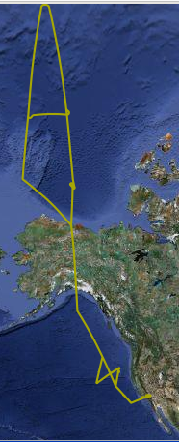
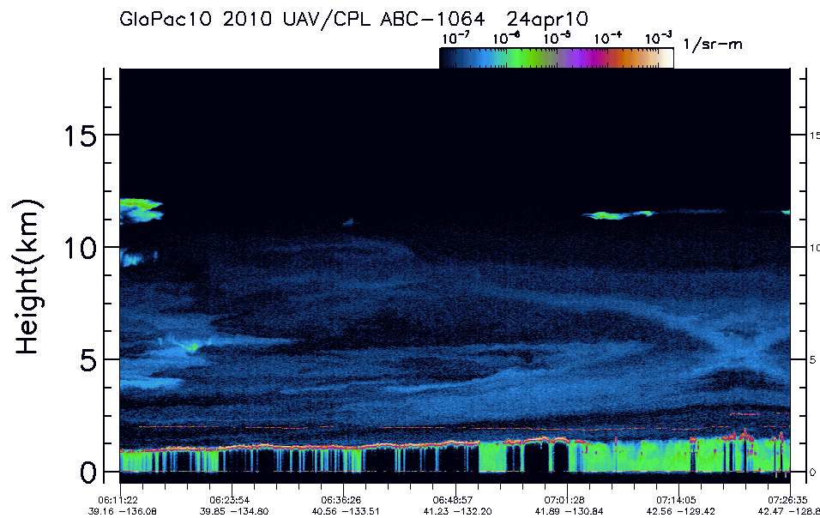
New High Altitude UAS
Science Capability
23 April 2010 Global Hawk Accomplishments
Partnership with NASA
Flight endurance – 28.6 hrs; Flight range – 9700 nm;
Maximum altitude – 19.9km; Maximum latitude – 85N
First time any Global Hawk has ever traveled north of 70
latitude
Collected, recorded, and relayed real-time readings of in
situ stratospheric ozone, water vapor, methane, carbon
monoxide, nitrous oxide, hydrogen, and sulfur
hexofluoride concentrations along entire flight track
Captured high definition visible imagery of sea ice
Cloud Physics Lidar remotely sensed dust
concentrations crossing the Pacific Ocean from
31 March 2010 Gobi Desert dust storm
Clouds obscure dust
Mainly cloud free
Dust plume moves east
NASA aerosol model forecast and Global Hawk flight track
Global Flight
Track for
23 April 2010
Dust -free
Dust
Clouds
Aerosol vertical profile observed by Cloud Physics Lidar along red arrow of flight track above
High definition visible images of sea ice captured by NASA Airborne Compact Atmospheric Mapper
Images courtesy of Dr. David Fahey , CDR Philip Hall, and NASA

Slide 11
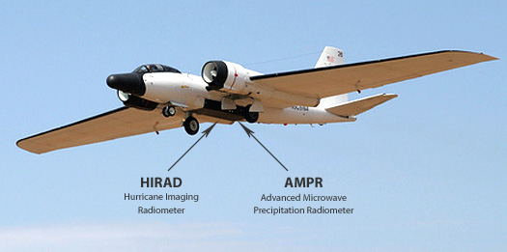
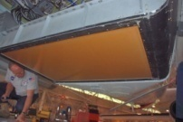
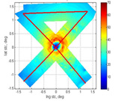
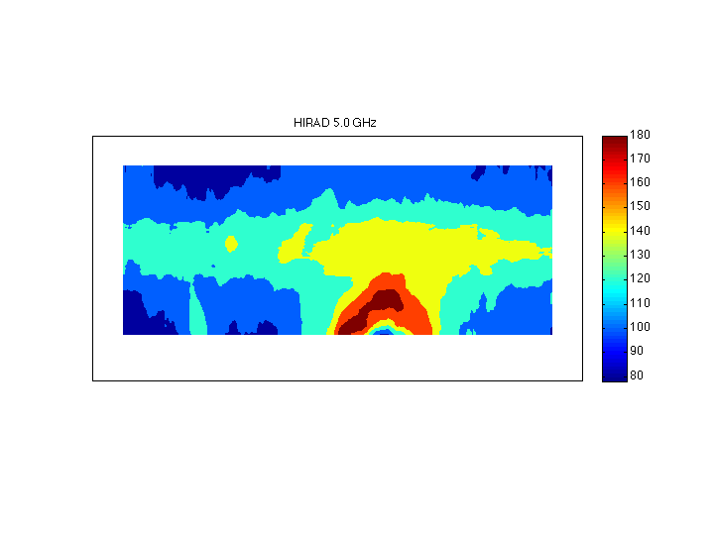
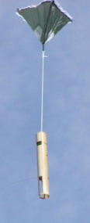
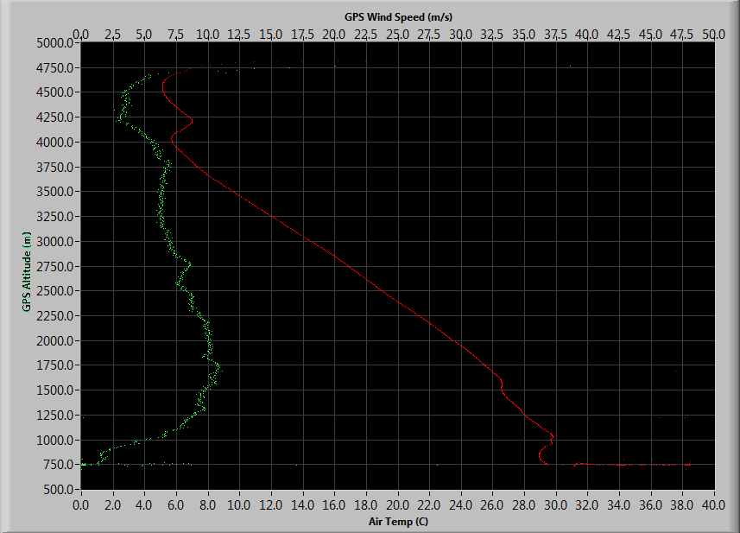
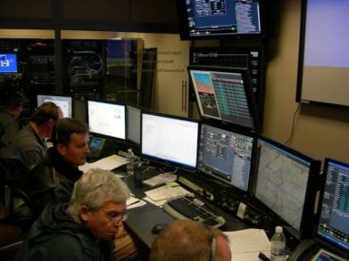
High Impact Weather Monitoring -
Global Hawk Hurricane Mission
NOAA Unmanned Aircraft Systems (UAS) Program contributed ~ $3.5M to
demonstrate potential high altitude platform and payload UAS technologies
Hurricane Earl 5 GHz Brightness Temperature
OSSE Ocean Surface Winds
Global Hawk Pilot /Deputy Project Manager
Global Hawk Flight Hour Funding
Development , Deployment, and Science
Support of Dropwindsonde System for Vertical Meteorological Profiles and Turbulence Sensor
for Situational Awareness
WB-57 Flight Hour Funding
Development , Deployment, and Science
Support of Hurricane Imaging Radiometer as Future UAS Hurricane Ocean Surface Wind and Rainfall Sensor

Slide 12
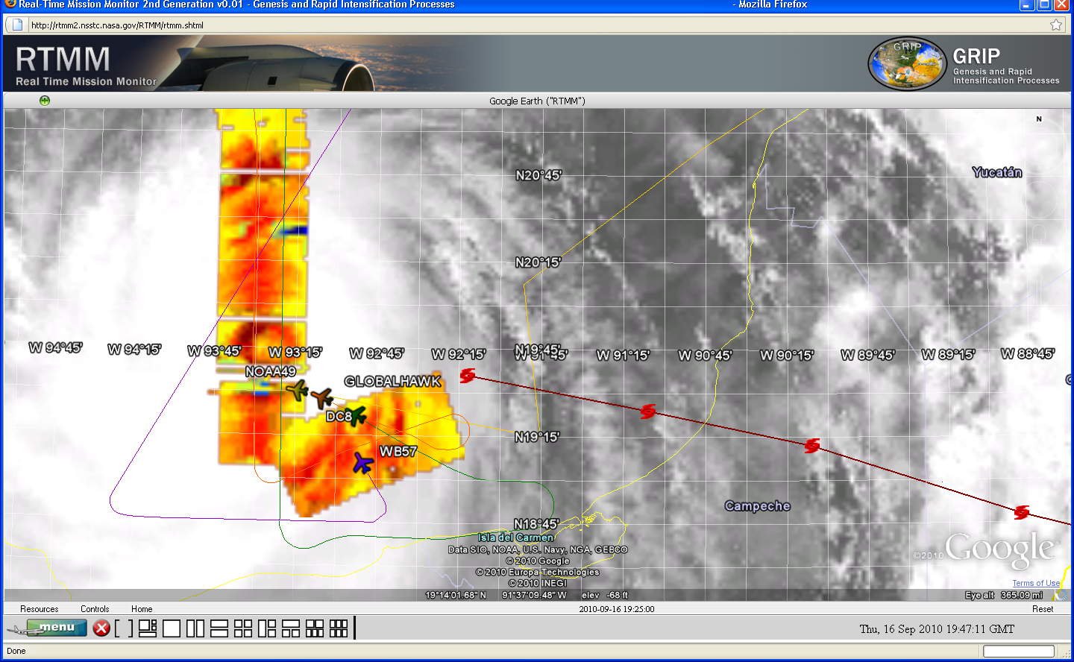
Real Time Situational Awareness
Screen capture of NASA Real Time Mission Monitor showing the NOAA 49 and NASA Global
Hawk, DC8, and WB57 making a coordinated pass over Hurricane Karl eye. A NOAA P3
(NOAA 42) and an Air Force C130 were also sampling the storm at this time. (Image provided by
Dr. Richard Blakeslee, NASA Global Hawk Mission Scientist)

Slide 13
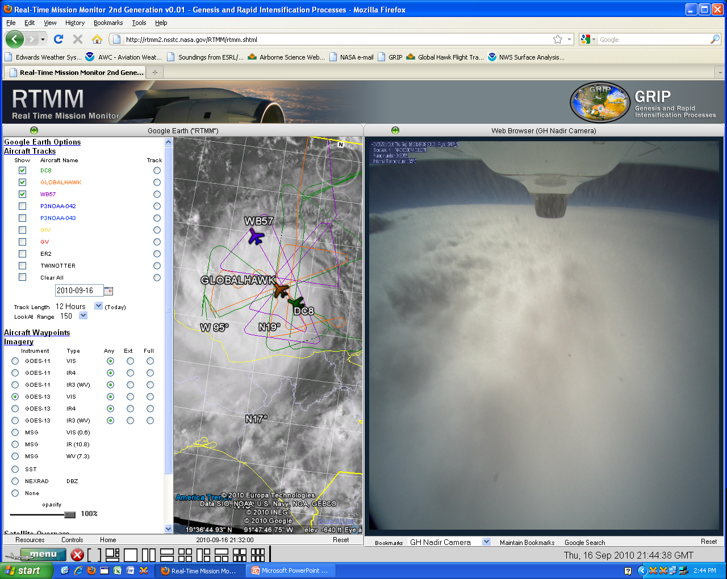
Real Time Situational Awareness
Screen capture of NASA Real Time Mission Monitor showing the aircraft tracks of NASA WB57, Global Hawk, and DC8 displayed over a NOAA GOES-13 visible image of Hurricane Karl in the center panel. The image in the right panel is a simultaneous view of the hurricane eye provided by the Global Hawk high definition visible camera. The Real Time Mission Monitor was developed by the
NASA Marshall Space Flight Center.

Slide 14
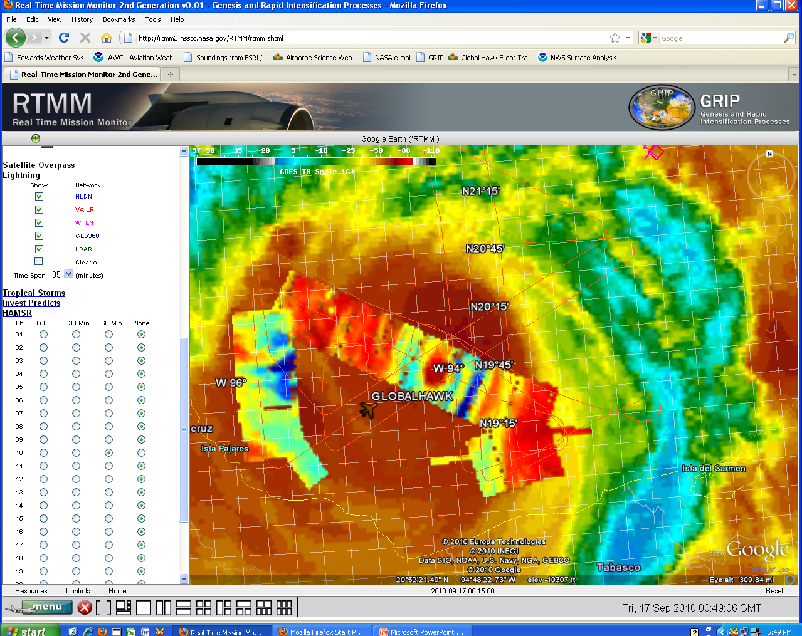
Real Time Situational Awareness
Screen capture of NASA Real Time Mission Monitor showing a NOAA GOES-13 infrared image of Hurricane Karl with overlays of the flight track of the Global Hawk and real-time passive microwave imagery collected by the High-Altitude Monolithic Microwave Integrated Circuit Sounding Radiometer (HAMSR) on the Global Hawk. HAMSR was developed by the Jet Propulsion Laboratory.

Slide 15
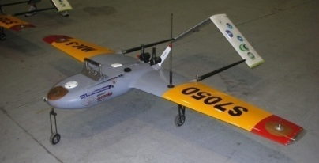
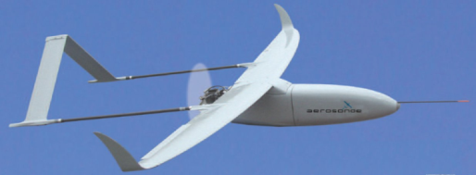
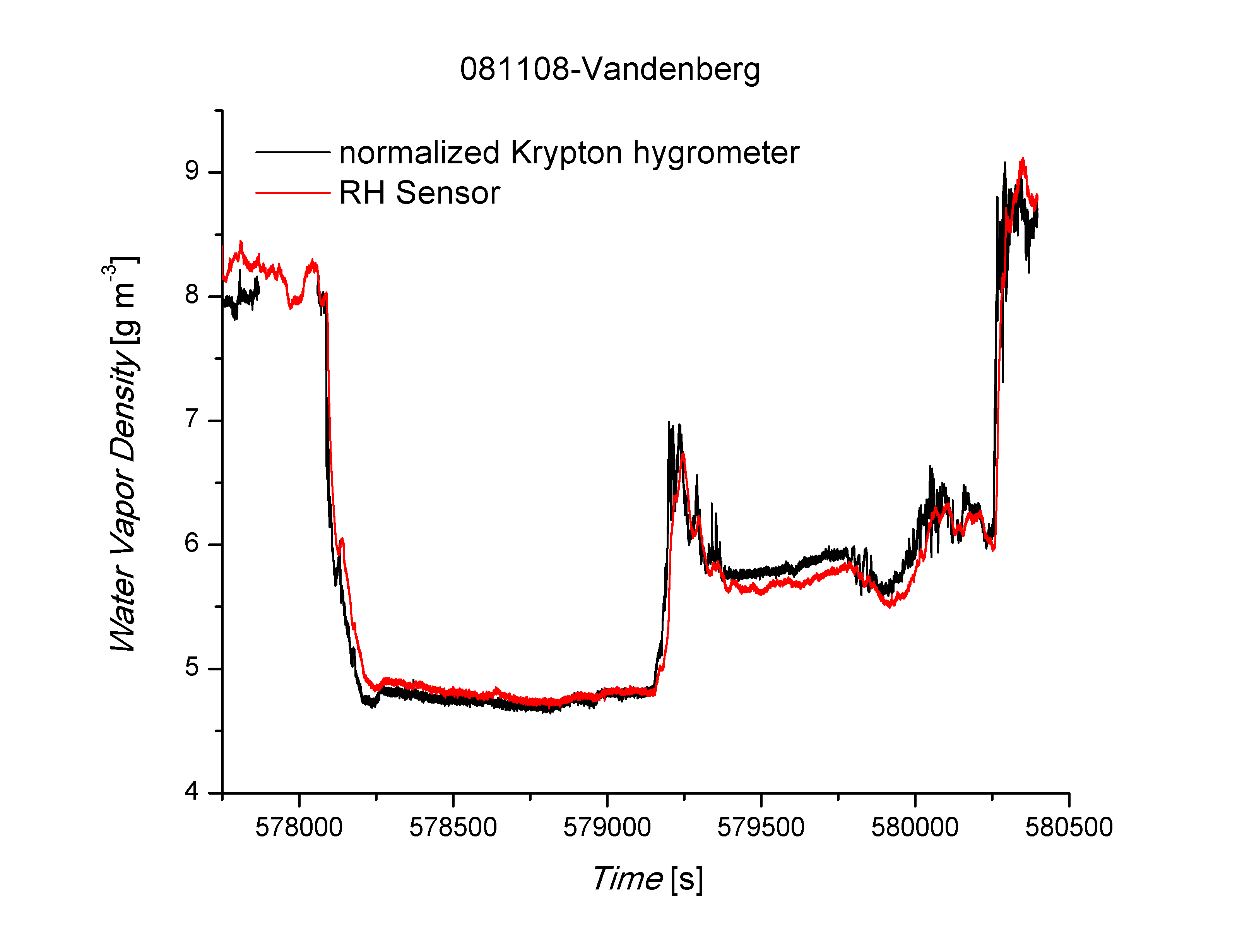
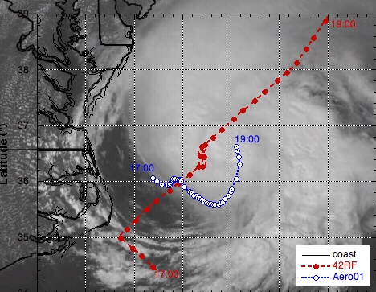
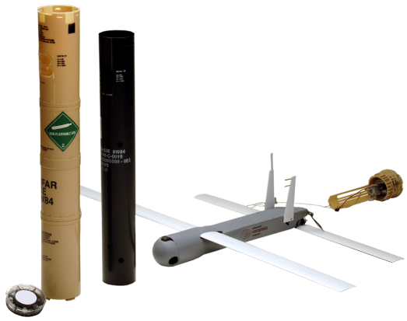
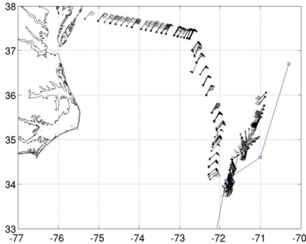
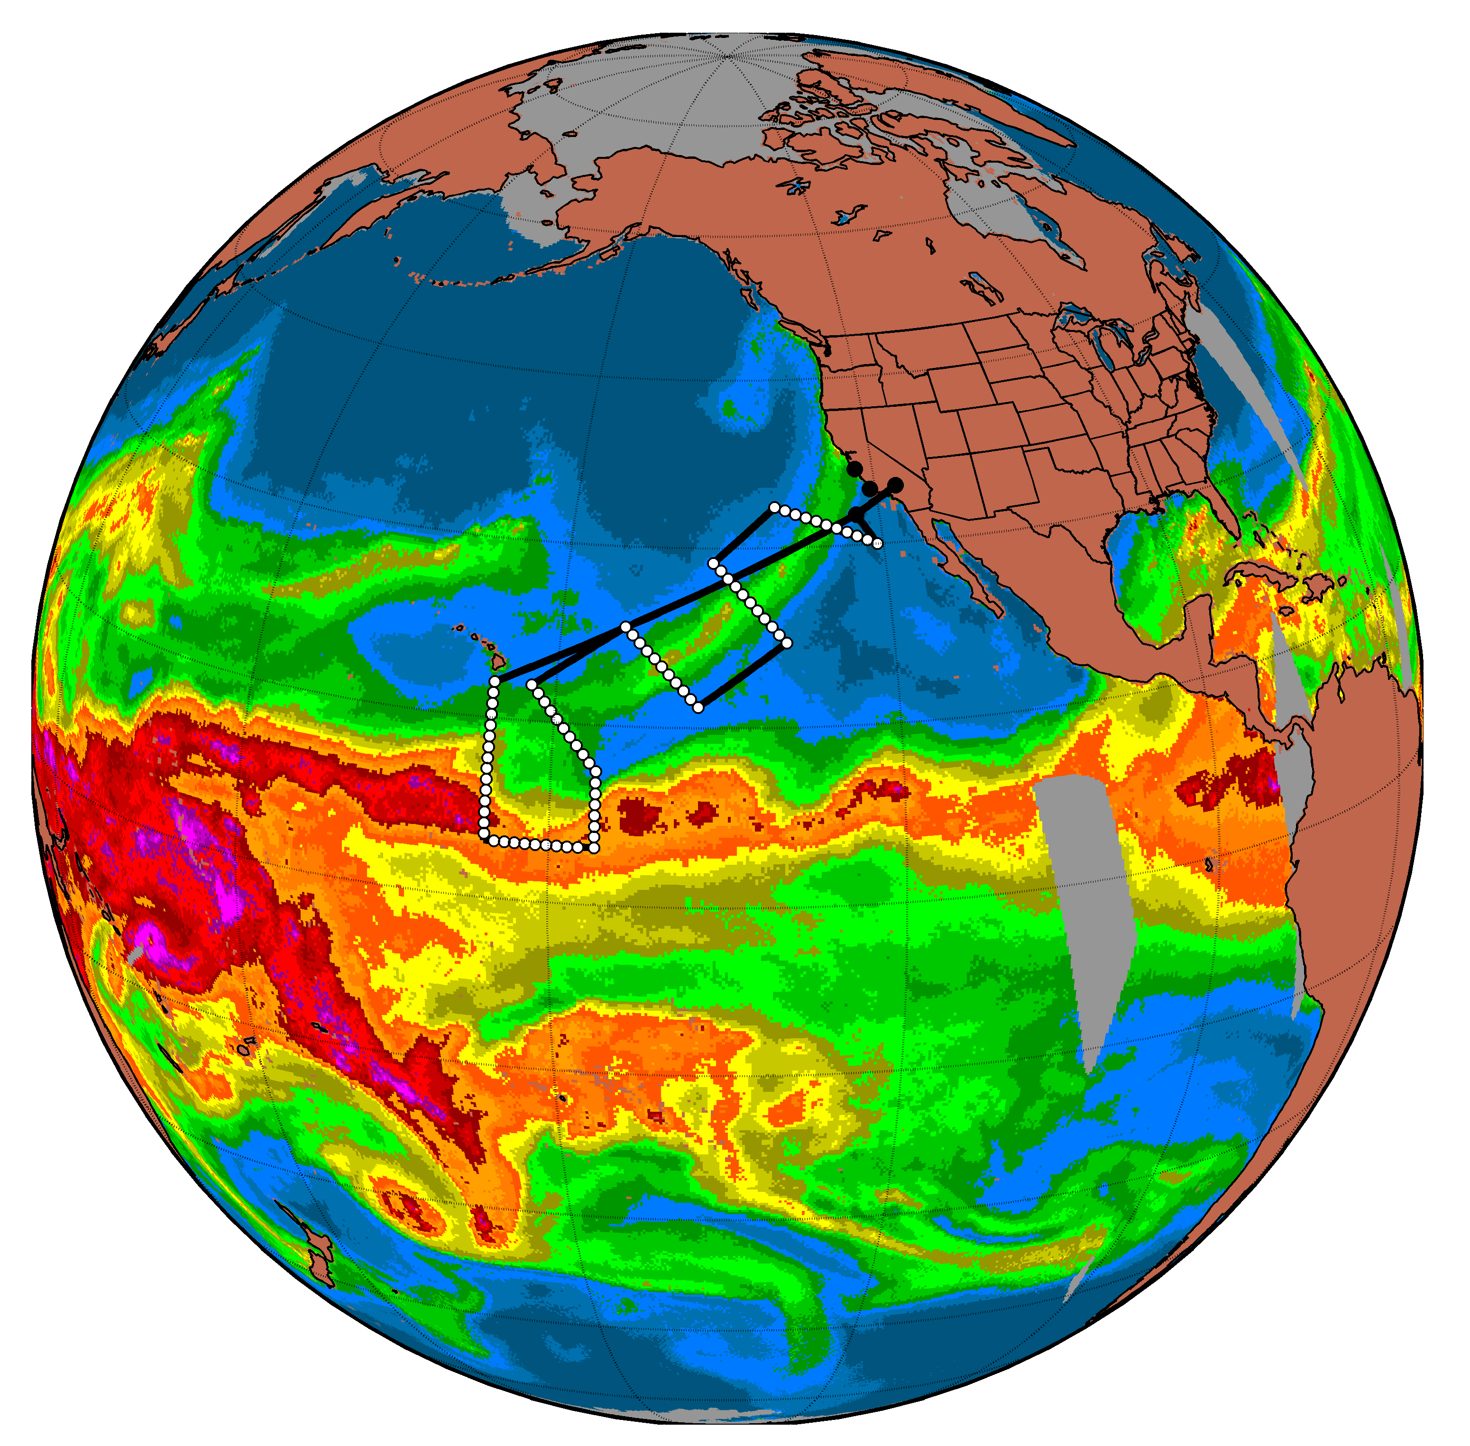
High Impact Weather Monitoring – Low Altitude
Atmospheric Rivers
Hurricanes
Expendable Sonde Launched from P-3 Manned Aircraft
Preliminary water vapor data
Hurricane Ophelia Imagery
Embry-Riddle Development with
NOAA AOC and HRD
Hurricane Noel Wind Data
Integrated Water Vapor
From SSM/I

Slide 16
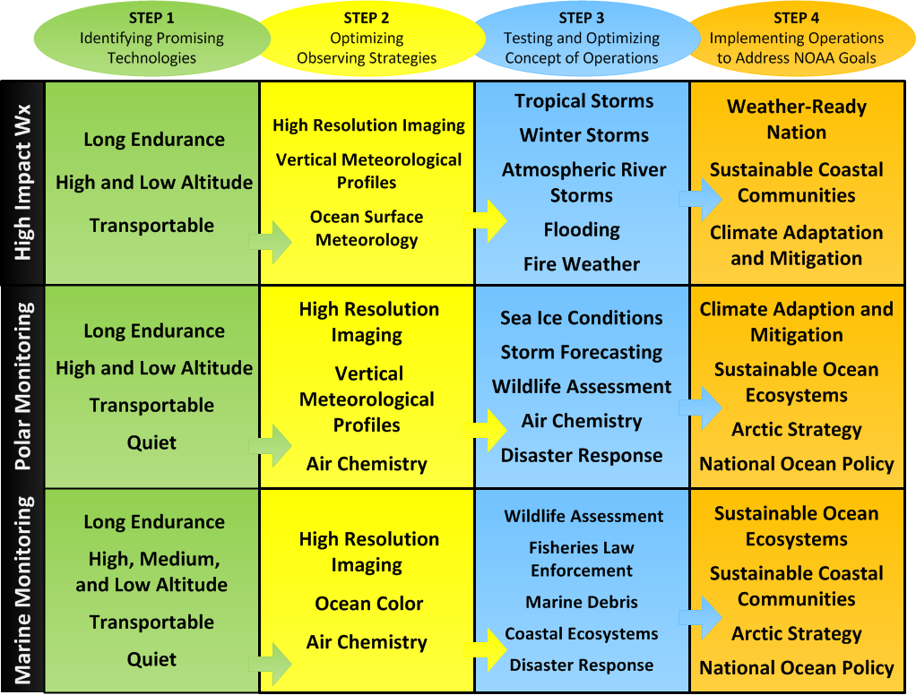
NOAA UAS Research to Application Roadmap for Monitoring Missions

Slide 17
UAS Systems Analysis
Developer
Solutions
Scientific
Systems
Analysis
Customer
Requirements
OAR systems leadership in partnership with OMAO, TIPO and Line Offices
UAS technology community
Line Offices Needs
Tell us what your needs are?

Slide 18
Backup Slides

Slide 19
UAS Technology Readiness Level (TRL) Assessment
TRL DEFINITION
Basic principles observed and reported
Technology concept and/or applications formulated
Analytical and experimental critical function and/or characteristics
Component and/or breadboard validation in laboratory environment
Component and/or breadboard validation in relevant environment
System/subsystem model or prototyping demonstration in a relevant environment (ground or air)
System prototyping demonstration in a flight environment
Actual system completed and “flight qualified” through test and demonstration (ground or air)
Actual system “flight proven” through successful mission operations

Slide 20
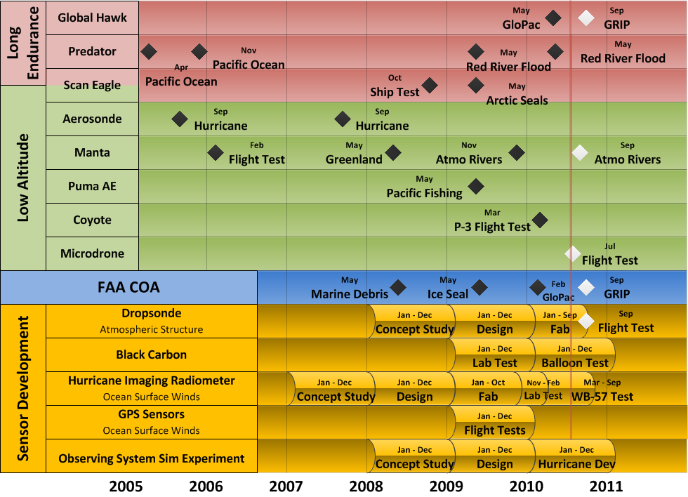
UAS Program Accomplishments

Slide 21
Database Overview
Requirements
Mission Based Requirements
Verification Methods
UAS Vehicles
Performance Information
Cost Information
Sensors
Design Specification
Experience
Applicable Platforms / Sensors
Test Demonstration Missions
Mission Description
Mission Manager
UAS Vehicle
UAS Classification
Sensor Type
The database is developed using FileMaker Pro.

Slide 22
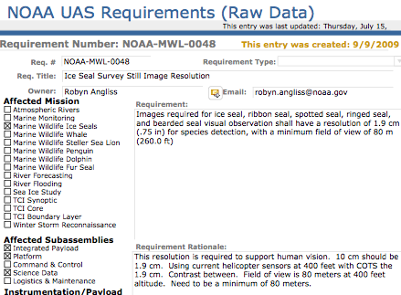
Requirements Overview
Atmospheric Rivers
Marine Monitoring
Sea Ice
Tropical Cyclone
Marine Wildlife
Winter Storm
Mission Centric
Requirements
Requirement Attributes:
Applicable Instrumentation Type
Applicable Platforms Type
Applicable Subassemblies
Verification Methods
Mission Category

Slide 23
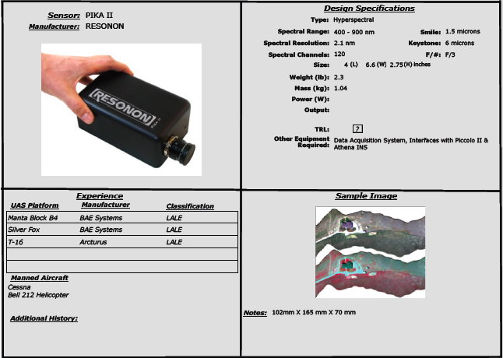
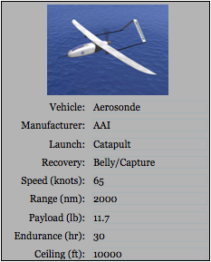
Vehicle and Sensor Information

Slide 24
Current Database Statistics
Vehicle Information Captured:
Performance Data: 59
Cost Data: 14
Sensors Captured: 30
Requirements
Mission Requirement Categories: 15
Total Mission Requirements: 296
Demonstration Missions: 15 of 19 Captured

